Slide 1
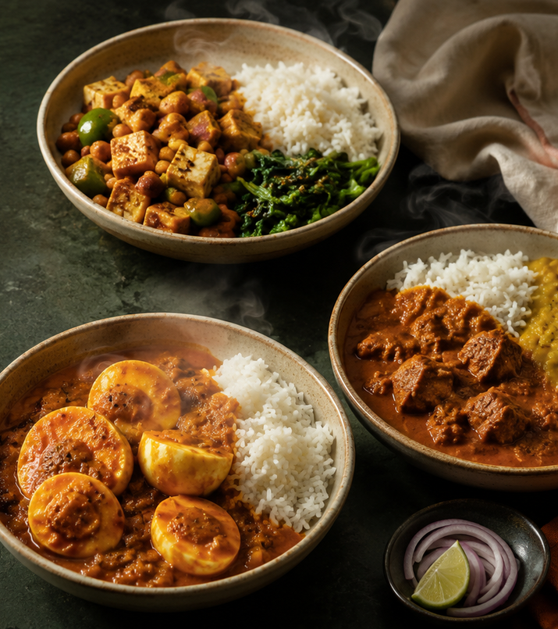
PILOT BUSINESS PLAN
DABBA40
40g protein. Home-style food. Three clear prices.
Veg ₹149
Eggitarian ₹169
Chicken ₹199
A 20-meal weekday lunch plan, cooked in our own rented cloud kitchen and delivered locally by the founders during the pilot.
3
₹82–115
312
₹3L
tiers — veg, eggitarian, chicken
meals per month to cover fixed costs
to run the first founder-led pilot
cash left per meal during the pilot
Shabareesh Parlakota
·
Vaishnavi Nanda Kandala
·
Param Parekh
·
Mansa Bihani
Notes:
DABBA40: 40g protein, ghar ka khana, three honest prices. Prepaid weekday lunch, cooked by us in a kitchen slot we control.

Slide 2

THE PROBLEM
02 / 09
Customers have three bad choices.
Rahul is a 26-year-old professional. He works out four times a week and buys lunch every weekday. This is an example customer.
Inexpensive tiffin
Affordable for daily use, but protein is not planned or measured.
Protein is unclear
Healthy delivery meal
Costs more and may still not provide 40g protein.
Expensive, protein unclear
Cook it himself
Can reach 40g, but takes daily time to plan, cook and clean.
Takes too much time
What he wants
A reliable home-style lunch with 40g protein at a clear price.
No simple option today
The opportunity is affordable daily meals from one kitchen, with protein customers can check.
Notes:
Rahul is an illustrative persona, not research. Every option fails on protein, price or time.

Slide 3
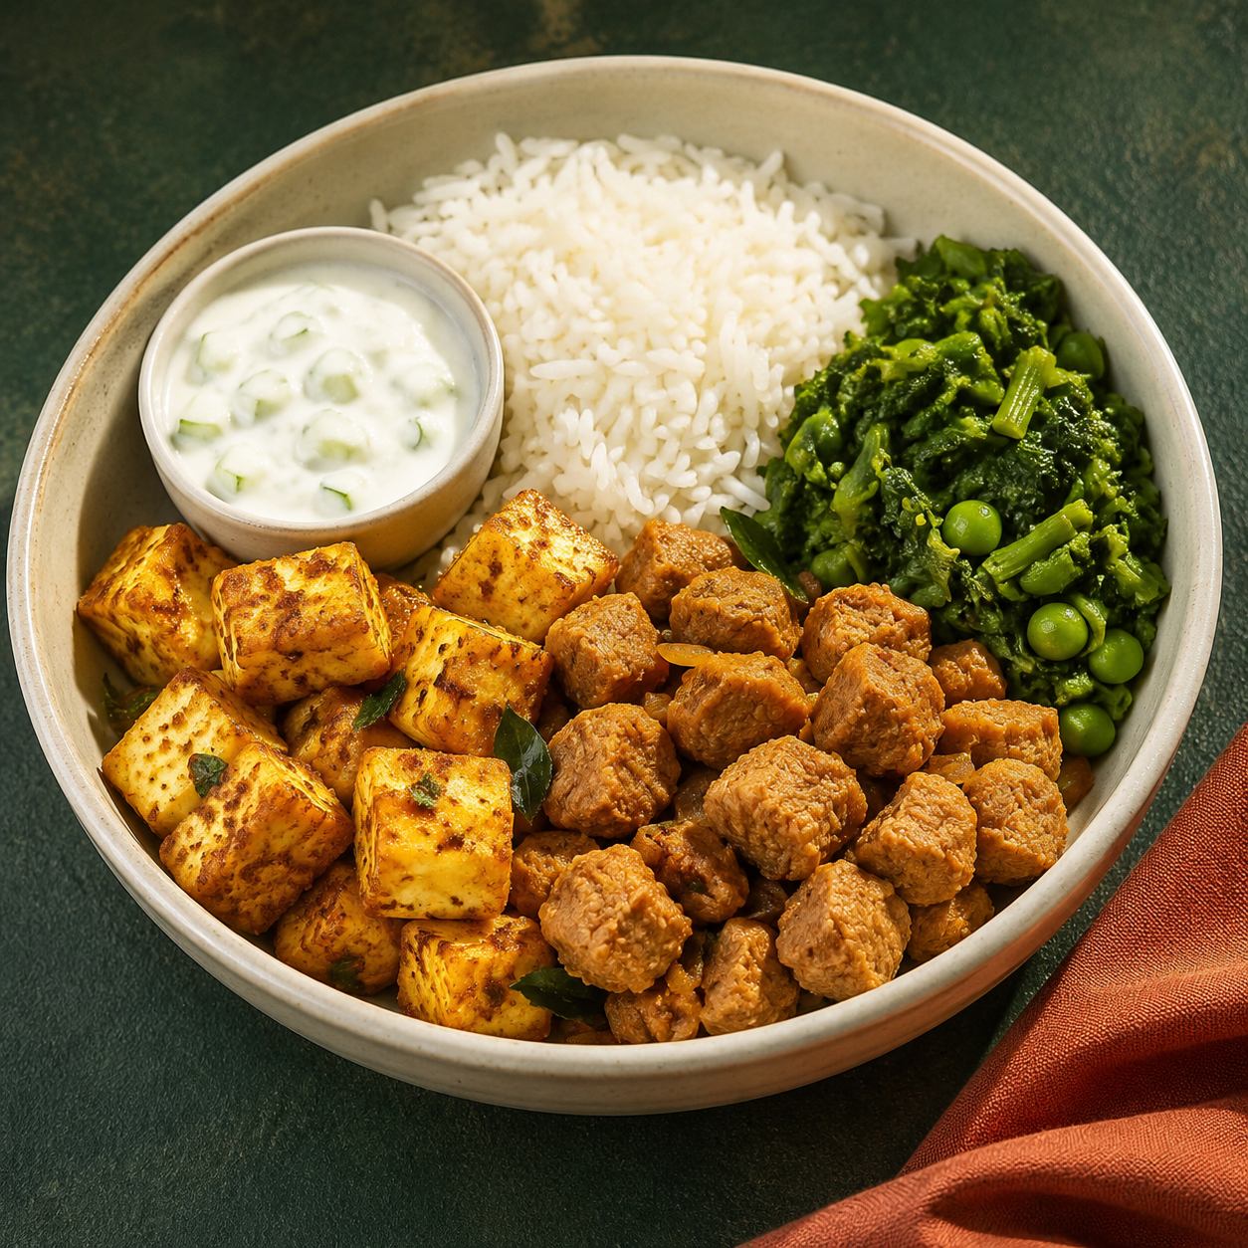
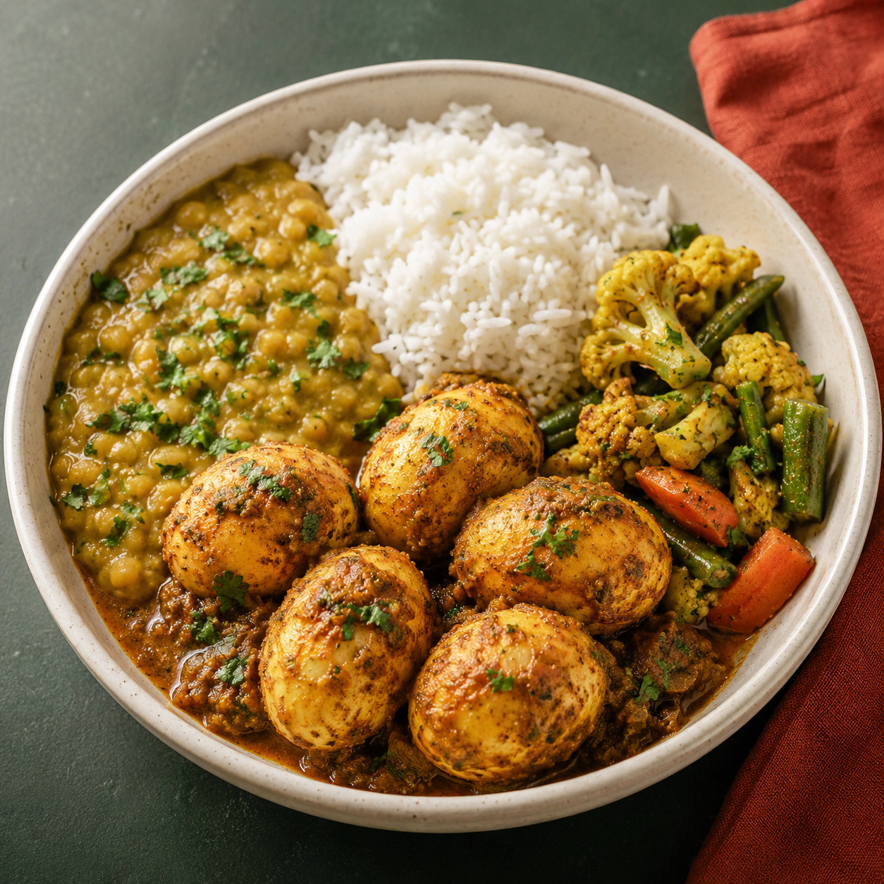
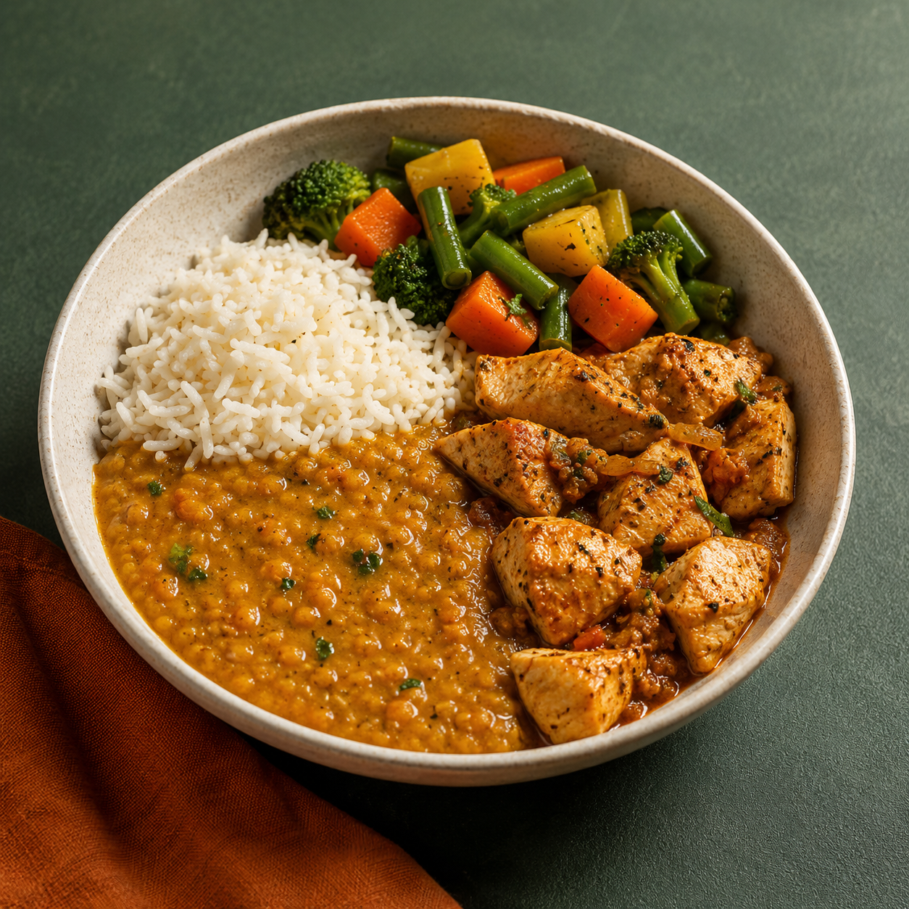
THE PRODUCT
03 / 09
Three meal choices. One 40g protein target.
Choose any tier in a 20-meal weekday pack.
₹149
₹169
₹199
VEG
EGGITARIAN
CHICKEN
Paneer + soya
Five eggs + dal
Chicken breast + dal
Target: about 44–45g protein.
Target: about 48–49g protein. Eggs are the only non-veg ingredient.
Target: about 41–42g protein.
₹2,980 for 20 meals
₹3,380 for 20 meals
₹3,980 for 20 meals
Customers choose the protein source. We keep the same quality standard.
Protein will be tested in finished meals before launch. Current values are pilot estimates.
Notes:
Same 40g proposition, three protein sources. The ₹169 meal is eggitarian — never described as vegetarian.

Slide 4
UNIT ECONOMICS
Every meal leaves cash to cover fixed costs.
04 / 09
Raw material
Packaging ₹11
Self-delivery fuel ₹4
5% spoilage buffer
Cash left after variable costs
AVERAGE ACROSS ALL THREE
₹97.13
cash left per meal after variable costs, on an average price of ₹172.33 (56.4%).
Veg ₹149
₹50
₹11
₹81.5
50g dry soya + 60g paneer
Variable cost ₹67.5
Margin 54.7%
Eggitarian ₹169
₹56
₹11
₹95.2
5 eggs + 40g dry dal
Variable cost ₹73.8
Margin 56.3%
Raw material is about one-third of every meal price.
Chicken ₹199
₹66
₹11
₹114.7
~120g raw chicken + 40g dry dal
Variable cost ₹84.3
Margin 57.6%
33.6% · 33.1% · 33.2% — a useful planning range. Real profit still depends on fixed costs and wages.
These numbers do not include founder cooking or delivery pay. Ingredient prices, recipes and protein content need real quotes and finished-meal tests. Chicken assumes about ₹400/kg. GST treatment must be confirmed with a CA.
Notes:
New costing slide. Raw material sits near one third of price in all three tiers; every tier contributes cash before founder labour.

Slide 5
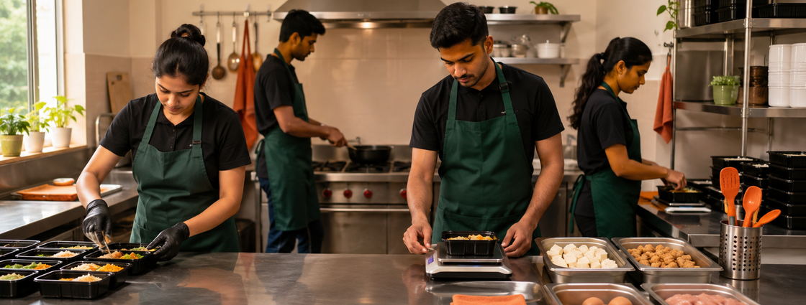
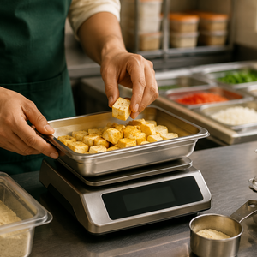
HOW WE BUILD TRUST
05 / 09
We control the kitchen, so we control quality.
One rented kitchen. Three separate meal lines. One clear protein target.
Approved suppliers
Our kitchen slot
Separate prep & checks
Pack & deliver ourselves
Customer
₹50 / ₹56 / ₹66
Founders cook during the pilot and control recipes, buying and prep. We publish our FSSAI number and kitchen address.
Separate, colour-coded storage and utensils for veg, egg and chicken. We weigh protein, use recipe cards, record batches and show allergens.
₹11 + ₹4
₹149 / ₹169 / ₹199
Fixed ingredient targets, approved suppliers and batch records.
₹11 packaging + ₹4 fuel because the founders deliver.
20-meal packs. We handle complaints, credits and remakes directly.
We rent the kitchen. We cook, weigh and deliver every meal. We own the result.
This is not a pure-veg kitchen because it also handles eggs and chicken. Vegetarian ingredients and utensils stay separate and clearly marked. We will test this process regularly.
Notes:
We do not partner with restaurants. We lease a dedicated slot and run production ourselves.

Slide 6
BREAK-EVEN
We cover fixed costs at 312 meals per month.
06 / 09
MONTHLY FIXED CASH COST
MEALS NEEDED PER MONTH
Kitchen slot
₹15,000
372
Electricity
₹4,000
319
312
Marketing
₹5,000
265
LPG
₹2,500
Cleaning & repairs
₹1,500
Water
₹1,000
Internet & phone
₹800
FSSAI cost allowance
₹500
Veg only
Eggitarian only
Chicken only
Equal mix of all three
₹30,300
18.6 / weekday · ₹30,300 ÷ ₹81.50
16.0 / weekday · ₹30,300 ÷ ₹95.20
13.3 / weekday · ₹30,300 ÷ ₹114.70
15.6 / weekday · ₹30,300 ÷ ₹97.13
Total
At an equal mix, 16 customers on 20-meal plans cover monthly fixed costs.
This is pilot break-even, not company break-even. It does not include founder salaries or paid kitchen and delivery staff. The equal mix is an assumption until customers place real orders. Rent and FSSAI costs need final quotes.
Notes:
₹30,300 detailed fixed cost. Equal mix breaks even at 312 meals — about 16 weekday lunches a day, or 16 active subscribers.

Slide 7
GO TO MARKET
Start with one kitchen and nearby customers.
07 / 09
THE CUSTOMER LOOP
FIND CUSTOMERS
Reach people through nearby gyms, trainers, offices, coworking spaces, homes and PGs. Share proof from our kitchen.
Gyms & trainers
GET FIRST ORDERS
Offices & coworking
Offer paid samples at normal prices or a clearly priced trial.
KEEP THEM
Rotate tastes, deliver reliably, keep the 20-meal plan flexible and show clear protein records.
PILOT KITCHEN
GET REFERRALS
Use only fixed, budgeted referral credits.
Homes & PGs
Walking and scooter delivery area
TRACK
Customer cost = marketing spend ÷ new paying customers
Month-2 retention = customers who reorder in Month 2 ÷ Month-1 customers
Repeat rate = second packs ÷ completed first packs
THE FIRST CUSTOMER
Pilot targets: 16 active customers for fixed-cost break-even; track repeat orders; confirm ingredient costs and protein for all three meals. The ₹5,000 marketing amount is a budget, not a proven customer cost.
A 22–35-year-old professional who lives or works nearby, buys lunch often, lacks a reliable cook and exercises at least three times a week.
Notes:
One kitchen, one walkable radius, paid trials only. No CAC or LTV claimed until real data exists.

Slide 8
SCALE GATE
Hiring staff is the real scale test.
08 / 09
WEEKDAY MEALS PER DAY TO BREAK EVEN
SEQUENCE
~61
Founder-run pilot
Prove people reorder and confirm all three meal costs.
example with paid staff
Add paid staff
Replace founder work with salaries and recalculate.
Open another kitchen
Expand only when one staffed kitchen covers costs and keeps customers.
Add new products
Add-ons come only after lunch repeat orders are strong.
~16
founder-run pilot
₹30,300 fixed costs · ₹97.13 cash left per meal · founders cook and deliver · 312 meals per month.
Adding an operator, cook, helper and paid delivery raises fixed costs to ₹1,00,300 and lowers cash left per meal to ₹83.13. Break-even rises to 1,207 meals per month.
Our advantage is trust built close to the customer.
Clear standards
→
Repeat orders
→
Steady demand
→
Shorter routes
→
Lower costs
→
Better local service
↻
Scale works only if customer demand grows faster than staff and delivery costs.
Notes:
Stress test, not forecast. Paid labour and ₹18 delivery move the gate from about 16 to about 61 meals a day.

Slide 9
MARKET & ASK
₹3 lakh to test demand, kitchen trust and all three meal costs.
09 / 09
Test one ₹3 lakh pilot before expanding.
Market estimate uses ₹41,360 yearly sales per average 20-meal customer.
Basic kitchen setup
₹80,000
TAM
₹662 Cr
Kitchen security deposit
₹50,000
Three months of fixed costs
₹90,900
200 possible mature clusters × 800 customers
Starting ingredients and packaging
₹25,000
SAM
₹165 Cr
₹10,000
Licences and meal testing
50 possible clusters in the first four cities
Buffer for price changes
₹44,100
₹19.9 Cr
Total pilot budget
₹3,00,000
SOM
Goal: six mature clusters
The pilot succeeds if customers reorder, all three meals test above 40g protein, real invoices confirm the margins, and the model still works after paying staff and delivery.
These cluster counts are planning estimates, not proven demand or secured revenue. We must check locations and demand before expanding. Sources: ICMR–NIN 2017, FSSAI rules and current retail price checks.
This budget assumes a mostly equipped rented kitchen. Confirm rent, equipment, ingredient and testing costs with real quotes before launch.
Notes:
₹3 lakh preliminary ask. Cluster counts are planning estimates; SOM is ambition, not secured revenue.

